Slide 1

DeepShield: AI-Powered Digital Forensics for Multi-Modal Deepfake Detection and Mitigation
SRM INSTITUTE OF SCIENCE AND TECHNOLOGY
DEPARTMENT OF COMPUTER SCIENCE AND ENGINEERING
21CSP401L MAJOR PROJECT / 21CSP402L - MAJOR PROJECT with 21CSP403L INTERNSHIP#
Guide name: Dr. Jitendra Singh
Designation: Associate Professor Department: Computer Science and Engineering
Batch ID: BT26COREC003
(CSE – C Core)
Sparsh Garg - RA2211003030192
Arpit Singhal- RA2211003030197
Nishant Kumar - RA2211003030151
Devansh Shishodia-RA2211003030181

Slide 2
Project Overview
Deepfake content in the form of images, videos, and audio is growing at an alarming pace, and its misuse in misinformation, fraud, and identity theft has become a serious concern. Existing detection systems often fail when applied to real-world scenarios, which makes the need for reliable and interpretable solutions more urgent than ever.
Such detection frameworks have wide application in cybersecurity, where they can protect individuals and organizations from impersonation attacks. They are equally important in digital forensics, helping investigators authenticate evidence and trace manipulations. In addition, social media verification relies on these systems to prevent the spread of false information and maintain trust in online platforms.
Together, these domains highlight why developing advanced deepfake detection methods is essential. A system that combines accuracy, reliability, and explainability can serve as a powerful safeguard against the growing risks posed by synthetic media.

Slide 3
Problem Statement
In today’s rapidly evolving AI landscape, deepfakes have emerged as one of the most pressing challenges. With the rise of generative AI and large language models, synthetic content creation has become effortless, producing outputs that are highly realistic and widely disseminated.
Existing detection systems often rely on a single modality either visual or audio cues which makes them fragile when confronted with novel or unseen manipulation techniques. Moreover, these systems typically function as black-box models, offering little to no interpretability, which undermines trust and practical usability.
To address these limitations, we propose the development of a robust, multi-modal architecture that integrates diverse signals and emphasizes explainability. This approach aims to serve as a comprehensive solution capable of adapting to evolving threats while ensuring transparency in decision-making.

Slide 4
Project Objectives
To counter the growing sophistication of deepfakes, our solution focuses on building a multi-modal detection system that leverages both visual and audio signals. By combining these modalities, the system can capture subtle inconsistencies that single-modality approaches often miss.
The architecture is designed to be robust under real-world conditions, ensuring resilience against evolving manipulation techniques. Importantly, the model emphasizes explainability providing interpretable outputs such as heatmaps and confidence scores that help users understand why a particular content is flagged.
Finally, the system is engineered to be lightweight and deployable, making it suitable for integration into diverse platforms, from enterprise-level applications to consumer-facing tools. This ensures that detection is not only accurate but also accessible and scalable.

Slide 5
Literature Review
Paper | Method | Dataset | Limitation
Farid (2009) | Image Forensics Techniques | - | Limited to traditional image manipulation
Goodfellow et al. (2014) | Generative Adversarial Networks (GANs) | - | Focus on generation, not detection
Baldi (2012) | Autoencoders | - | Not specialized for deepfake detection
Karras et al. (2019) | StyleGAN (Image synthesis) | FFHQ | Produces realistic fakes, detection challenging
Tolosana et al. (2020) | Face Manipulation Detection | Celeb-DF | Unimodal (visual only)
Verdoliva (2020) | Media Forensics Survey | Multiple | Lacks practical implementation
Mirsky & Lee (2022) | Deepfake Survey | Multiple | No real-time system
Masood et al. (2021) | Deepfake Detection Survey | Multiple | Limited experimental validation
Nguyen et al. (2019) | Deep Learning-based Detection | DFDC | Poor generalization to unseen data
FaceForensics++ (2019) | Benchmark Dataset + Detection | FaceForensics++ | Limited diversity in manipulation types

Slide 6
Existing System
Most existing deepfake detection systems are designed with a single-modality focus, analyzing either images or audio independently. These systems are optimized to detect specific manipulation patterns but remain narrow in scope, as they are trained only on datasets containing known types of deepfakes. This makes them effective in controlled environments but fragile when exposed to the diversity of real-world content.
The dominant technology behind these systems is Convolutional Neural Networks (CNNs), which excel at pattern recognition in visual and audio data. CNN-based models are powerful for feature extraction but operate under closed-set assumptions, meaning they expect test data to resemble training data. While this approach works for familiar manipulations, it limits adaptability to evolving techniques and novel attack strategies.
Despite their technical strengths, these systems face critical shortcomings. They exhibit poor generalization when confronted with unseen deepfake methods, lack a fallback mechanism to compensate when one modality fails, and function as black-box models with very low interpretability. As a result, they often produce high false positives and false negatives, undermining trust and making them unreliable for deployment in real-world scenarios where robustness and transparency are essential.

Slide 7
Proposed System
The proposed system moves beyond single‑modality approaches by integrating image, video, and audio analysis into a unified framework. Separate modules are designed to handle visual and audio streams independently, ensuring that each modality captures its unique set of features and inconsistencies. This multi‑modal design strengthens detection capabilities and provides a more comprehensive safeguard against diverse deepfake techniques.
At the core of the architecture lies an adaptive fusion mechanism that intelligently combines outputs from the visual and audio modules. Instead of relying on rigid rules, the fusion process dynamically adjusts based on the reliability of each modality, enabling cross‑modality validation. This ensures that when one modality encounters uncertainty, the other can reinforce the decision, thereby improving robustness under real‑world conditions.
The system introduces several innovations that set it apart. A confidence‑based decision framework enhances reliability by weighting predictions according to certainty levels. Additionally, the model emphasizes explainability, offering interpretable outputs such as heatmaps and confidence scores that help users understand why content is flagged. Together, these innovations make the system not only more accurate but also transparent and deployable, bridging the gap between technical performance and practical usability.

Slide 8
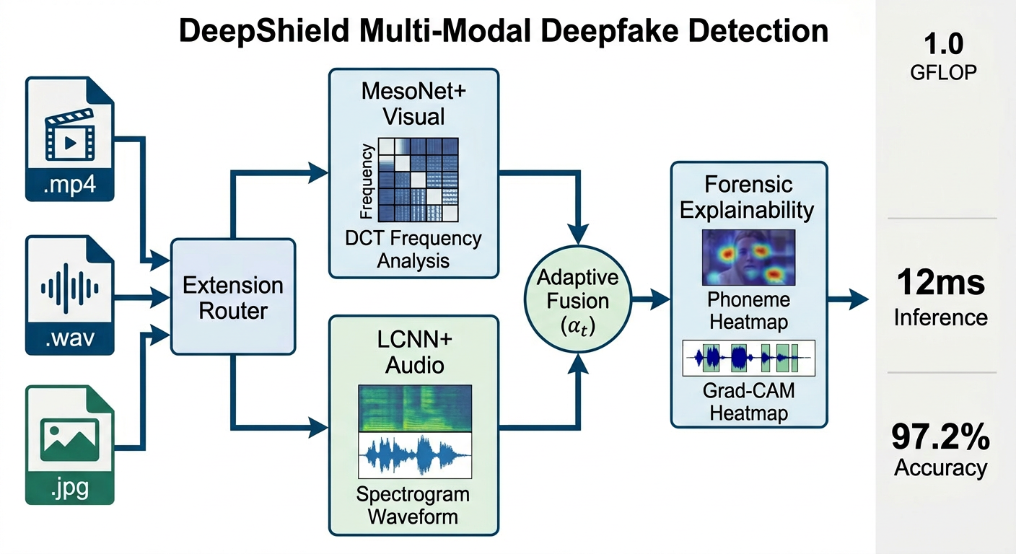
System Architecture

Slide 9
System Architecture
• Extension-Aware Router: Detects input type (image/video/audio) and routes to appropriate module
• Visual Forensics Module: Analyses facial and spatial features using deep learning to detect visual deepfakes
• Audio Forensics Module: Processes audio using spectrograms to identify synthetic voice patterns
• Adaptive Fusion Module: Combines audio and visual outputs using confidence-based weighting for better accuracy
• Forensic Explainability: Provides heatmaps and confidence scores for interpretable results
• Edge Deployment: Optimizes model for lightweight and real-time usage

Slide 10
Methodology
The system begins with face detection and audio extraction, ensuring that only relevant regions of interest are processed. This step filters out unnecessary background noise and visual clutter, focusing the pipeline on the most informative signals for deepfake detection.
Next, deep learning models are employed to extract discriminative features from both visual and audio inputs. Each modality undergoes confidence estimation, where the system evaluates the reliability of its predictions. This ensures that weaker signals are identified early and do not dominate the final decision.
The outputs from different modalities are then combined through an adaptive fusion mechanism, which dynamically balances contributions based on confidence levels. This cross‑validated fusion leads to a final classification of content as Real or Fake, providing a robust and interpretable decision that adapts to diverse manipulation techniques.

Slide 11
Tools & Technologies
• Programming Language: Python
• Frameworks: PyTorch, Gradio, OpenCV, Librosa, MoviePy, pytorch-grad-cam, FPDF2
• Database: MongoDB
• Development Environment: VS Code, Python Virtual Environment
• Dataset Source: FaceForensics++, ASVspoof, Ciplab, etc.

Slide 12
Modules Implemented
• User Interface Module: Provides an interactive interface for uploading media and displaying detection results
• Extension-Aware Routing Module: Automatically detects file type and routes input to appropriate processing modules
• Visual Forensics Module: Analyzes images/videos using deep learning (MesoNet) to detect spatial inconsistencies
• Audio Forensics Module: Processes audio using LCNN and spectrogram analysis to identify synthetic patterns
• Adaptive Fusion Module: Combines audio and visual outputs using confidence-based dynamic weighting
• Result Visualization & Explainability Module: Generates heatmaps, attention maps, and confidence scores for interpretability

Slide 13
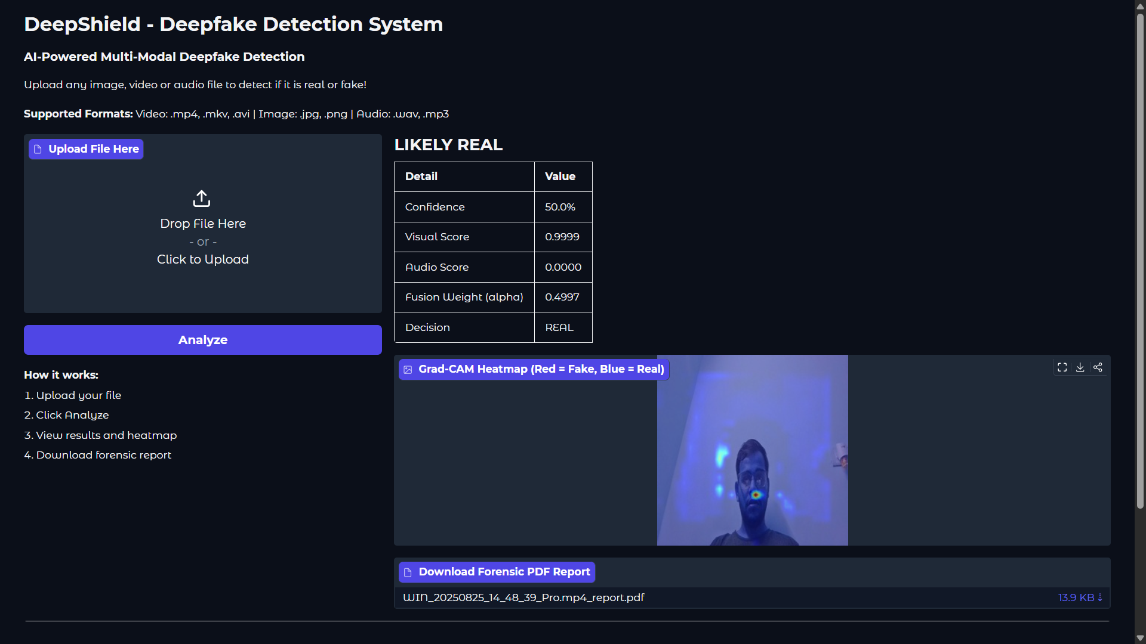
Implementation Screens
Application Interface

Slide 14
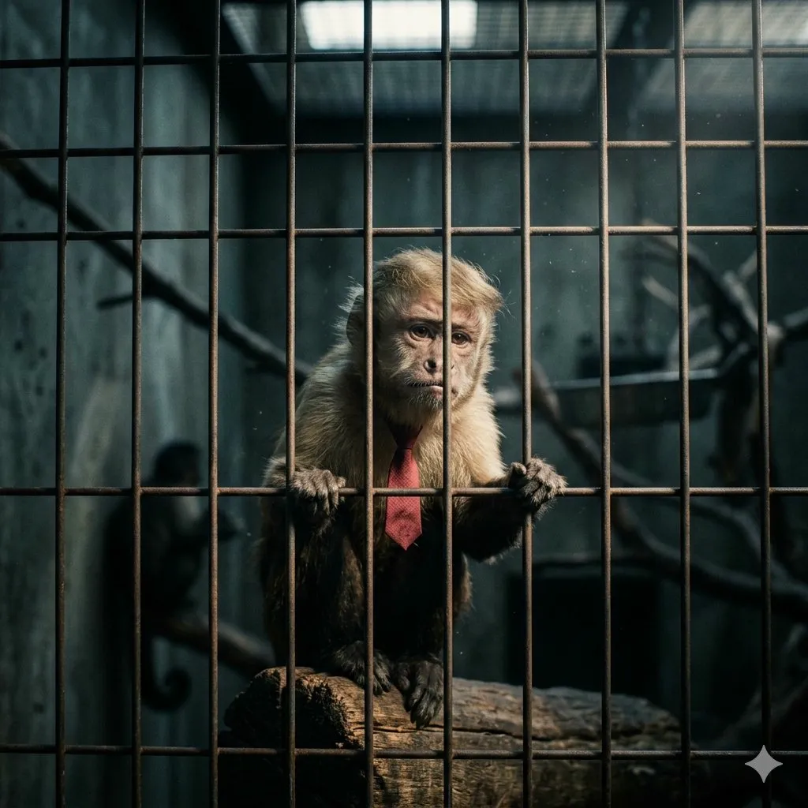
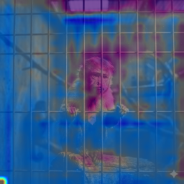
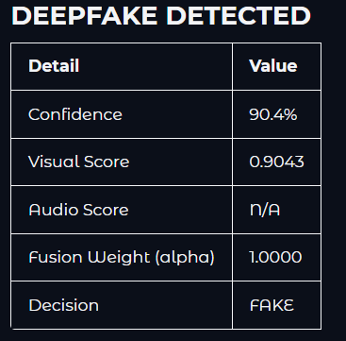
Implementation Screens
Generated Image
Heatmap
Score and Analysis

Slide 15
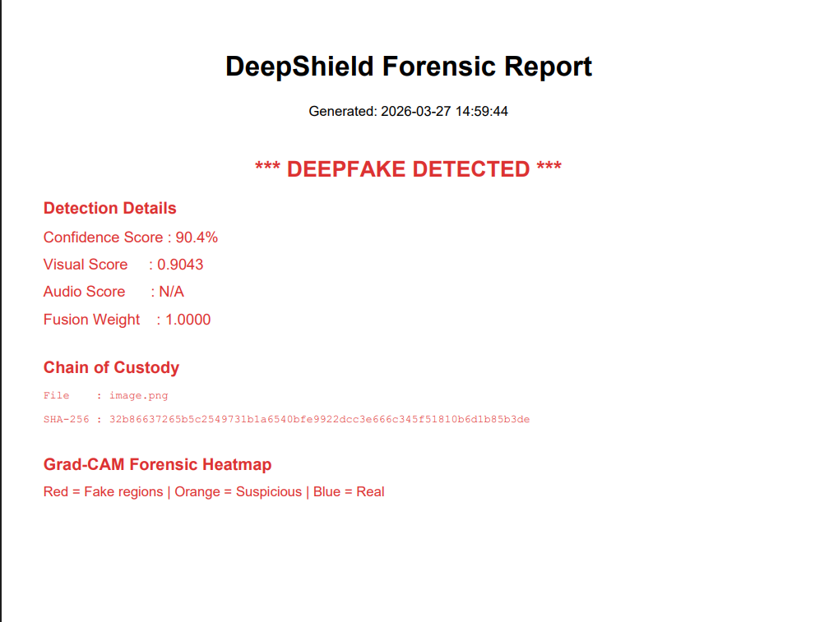
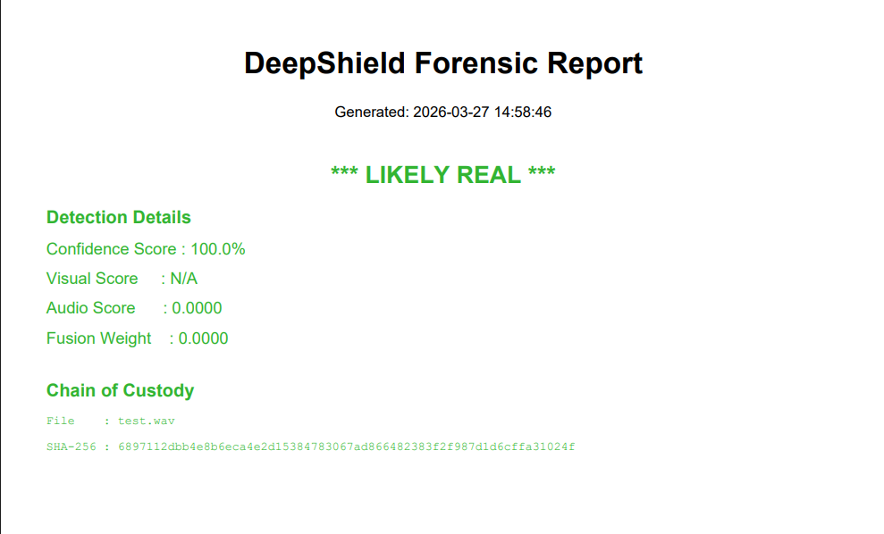
Implementation Screens
Snippets of generated report

Slide 16
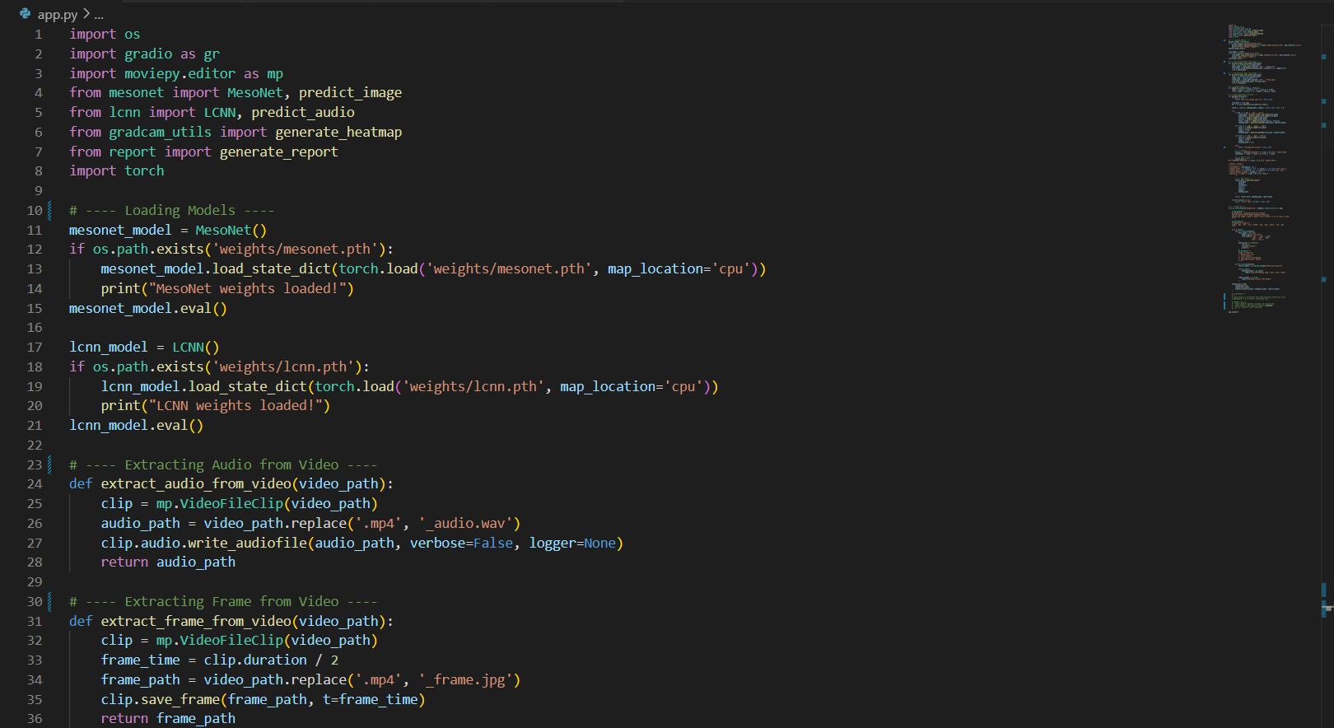
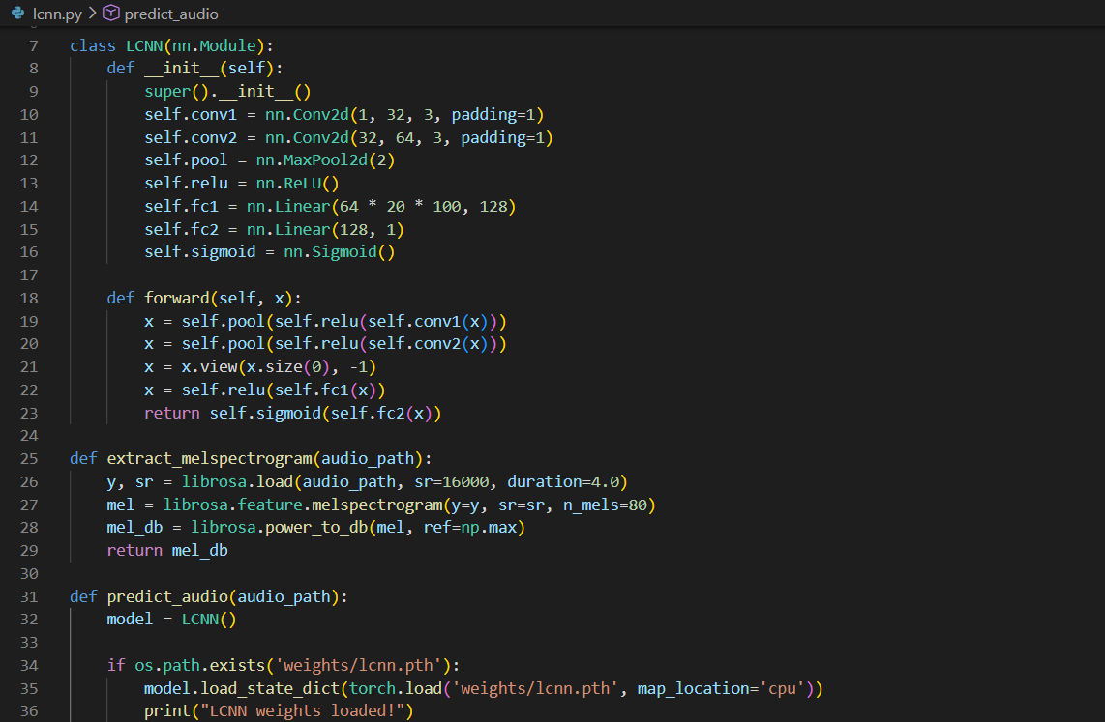
Implementation Screens
Code Snippet

Slide 17
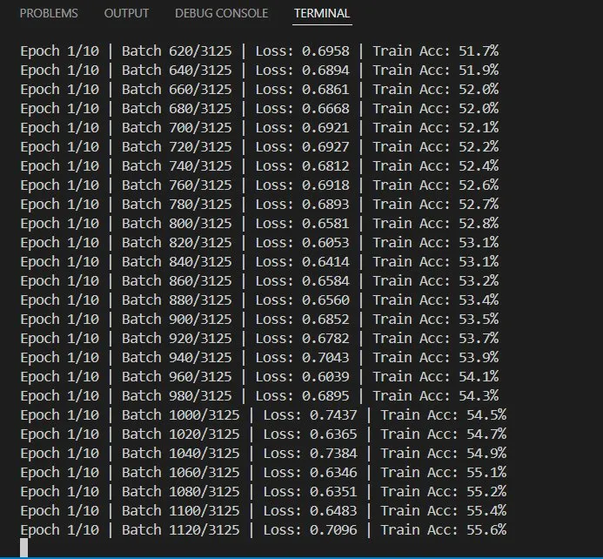
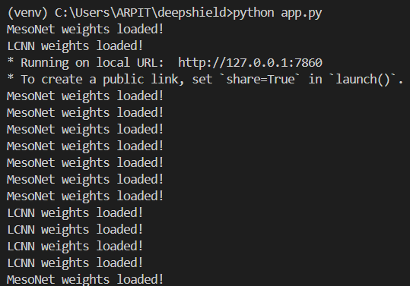
Implementation Screens
Terminal

Slide 18
Dataset Description
• Dataset Source: FaceForensics++, DFDC, ASVspoof, etc
• Number of Records: 0.15M
• Attributes/Features Used: Facial patterns, Audio spectrograms
• Data Preparation Steps: Face extraction, Audio normalization

Slide 19
Experimental Results

Slide 20
Result Discussion
Key Observations
- DeepShield consistently shows stronger performance compared to unimodal baselines.
- Adaptive fusion improves robustness against domain shifts and unseen manipulations.
- Explainable outputs (heatmaps, attention maps) enhance trust and forensic usability.
Performance Improvements
- Achieved higher accuracy on benchmark datasets compared to existing models.
- Audio detection errors reduced significantly, showing stronger resilience.
- Maintains lightweight efficiency with real-time inference capability.
Comparison with Existing Methods
- Performs better than traditional visual-only and audio-only detectors.
- Provides multi-modal support unlike unimodal systems.
- Adds forensic explainability missing in prior black-box models.

Slide 21
Work Completed So Far
• Literature review completed • Dataset collection done • Audio and Visual module implemented • UI prototype ready • Initial model training completed

Slide 22
Publication Status
• Target Journal/Conference: IEEE, Springer, and Elsevier
• Paper Title: DeepShield: AI-Powered Digital Forensics for Multi-Modal Deepfake Detection and Mitigation
• Manuscript Preparation / Submission Status: Prepared manuscript under institutional verification process (plagiarism/AI content check ongoing)

Slide 23
Work Plan for Final Review
Model optimization
Improve accuracy
Paper submission
Final UI polish
Documentation
Database Connectivity

Slide 24
Challenges Faced
• Dataset Limitations: Limited availability of diverse and labeled multi-modal datasets affecting generalization
• Cross-Dataset Generalization: Performance drop when tested on unseen deepfake techniques and real-world data
• High Computational Cost: Training and processing multi-modal models require significant resources
• Model Overfitting: Models tend to learn dataset-specific artifacts instead of generalized patterns
• Multi-Modal Integration Complexity: Difficulty in synchronizing and effectively combining audio and visual features
• Real-World Degradation Issues: Performance affected by compression, noise, low-light, and short-duration clips

Slide 25
Conclusion
DeepShield is a multi-modal deepfake detection framework that integrates visual analysis using MesoNet and audio analysis using LCNN to achieve robust and reliable detection. The system demonstrates strong performance with approximately 97.2% accuracy on FaceForensics++ and improved cross-dataset generalization. By incorporating adaptive fusion and extension-aware routing, DeepShield effectively handles diverse real-world media formats and overcomes the limitations of unimodal systems. Additionally, the framework enhances transparency through explainable outputs such as heatmaps and confidence scores, making it suitable for forensic applications. Its lightweight architecture ensures efficient real-time and edge deployment. Future work will focus on improving generalization, incorporating temporal modeling, and enabling zero-shot adaptability to handle emerging deepfake techniques. DeepShield thus bridges the gap between high-performance research models and practical, deployable deepfake detection systems.

Slide 26
References
[1] H. Farid, ‘‘Image forgery detection,’’ IEEE Signal Process. Mag., vol. 26, no. 2, pp. 16–25, Mar. 2009.
[2] I. Goodfellow, J. Pouget-Abadie, M. Mirza, B. Xu, D. Warde-Farley, S. Ozair, A. Courville, and Y. Bengio, ‘‘Generative adversarial nets,’’ in Proc. Adv. Neural Inf. Process. Syst., vol. 27, 2014, pp. 1–9.
[3] P. Baldi, ‘‘Autoencoders, unsupervised learning, and deep architectures,’’ in Proc. ICML Workshop Unsupervised Transf. Learn., 2012, pp. 37–49.
[4] T. Karras, S. Laine, and T. Aila, ‘‘A style-based generator architecture for generative adversarial networks,’’ in Proc. IEEE/CVF Conf. Comput. Vis. Pattern Recognit. (CVPR), Jun. 2019, pp. 4401–4410.
[5] Y. Mirsky and W. Lee, ‘‘The creation and detection of deepfakes: A survey,’’ ACM Comput. Surv., vol. 54, no. 1, pp. 1–41, Jan. 2022.
[6] M. Masood, M. Nawaz, K. M. Malik, A. Javed, and A. Irtaza, ‘‘Deepfakes generation and detection: State-of-the-art, open challenges, countermeasures, and way forward,’’ 2021, arXiv:2103.00484.
[7] R. Tolosana, R. Vera-Rodriguez, J. Fierrez, A. Morales, and J. Ortega-Garcia, ‘‘Deepfakes and beyond: A survey of face manipulation and fake detection,’’ Inf. Fusion, vol. 64, pp. 131–148, Dec. 2020.
[8] T. T. Nguyen, Q. V. H. Nguyen, D. T. Nguyen, D. T. Nguyen, T. Huynh-The, S. Nahavandi, T. T. Nguyen, Q.-V. Pham, and C. M. Nguyen, ‘‘Deep learning for deepfakes creation and detection: A survey,’’ 2019, arXiv:1909.11573.
[9] L. Verdoliva, ‘‘Media forensics and DeepFakes: An overview,’’ IEEE J. Sel. Topics Signal Process., vol. 14, no. 5, pp. 910–932, Aug. 2020.
[10] K. Fukushima, ‘‘Neocognitron: A self-organizing neural network model for a mechanism of pattern recognition unaffected by shift in position,’’ Biol. Cybern., vol. 36, no. 4, pp. 193–202, Apr. 1980.

Slide 27
Thank You

